Slide 1
3d-Printed Granular Jamming Hand
Maggie Serra
Chris Wallace
Melissa Indoe
Sean Phelan
Chris Kang

Slide 2
Conceptual Designs
To simplify the design process, brainstorming was split into categories:
Category 1: Hand Ideas
Ideas relating to the rigid components of the hand
Category 2: Granular Jamming Ideas
Ideas relating to the granular jamming pads
Category 3: Other Considerations
These were ideas or requirements that did not fit into any one category

Slide 3
Hand Ideas
Joint ideas
Ways to move joints
Pneumatics
Motors (one per joint)
Cables
One cable per finger
One cable per finger, share cable for ring and pinky
One cable per joint per finger
One cable for 2 joints per finger
Motors and cables (motors at finger base)
Ideas to hold position
Gear teeth at joint interface
External joint locks

Slide 4
Hand Ideas (continued)
Straightening out the hand
Long rubber bands
Dental rubber bands
Flat springs
A second set of cables
Sensing grip
No grip sense: vacuum activated by button
Place bump sensor under granular jamming pad
Place encoder on servo motor, see if servo is stalled

Slide 5
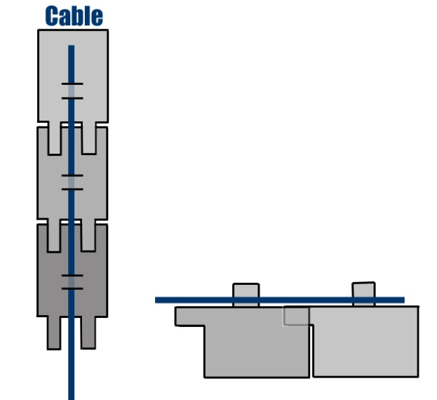
Joint Ideas Decision Matrix
Category: | Simplicity | Affordability | Range of Motion | Totals:
Category Weight: | 10 | 8 | 8
Item:
Pneumatics | 2 | 4 | 6 | 100
Motors (1/joint) | 1 | 1 | 10 | 98
Cables | 9 | 9 | 7 | 218
Motors & Cables | 6 | 7 | 8 | 180

Slide 6
Cabling Ideas Decision Matrix
Category: | Simplicity | Affordability | Range of Motion | Totals:
Category Weight: | 10 | 8 | 8
Item:
5 Cables (1/Finger) | 9 | 9 | 7 | 218
4 Cables | 9 | 10 | 5 | 210
1 Cable/Joint | 2 | 2 | 9 | 108
1 Cable/2 Joints | 4 | 4 | 8 | 136

Slide 7
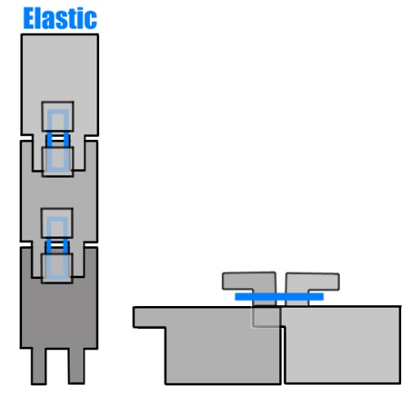
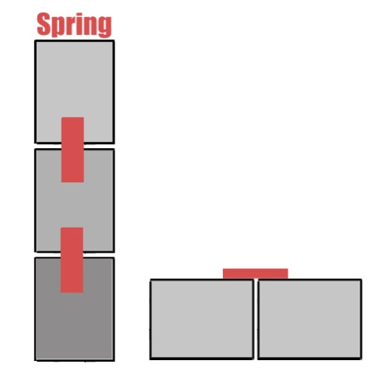
Hand Straightening Ideas Decision Matrix
Category: | Simplicity | Affordability | Reliability | Repairability | Range of Motion | Totals:
Category Weight: | 10 | 8 | 7 | 6 | 8
Item:
Long Rubber Bands | 8 | 9 | 4 | 2 | 7 | 248
Dental Rubber Bands | 6 | 9 | 5 | 9 | 7 | 277
Flat Springs | 8 | 6 | 9 | 5 | 7 | 277
Second Set of Cables | 4 | 2 | 8 | 7 | 9 | 226

Slide 8
Grip Sense Decision Matrix
Category: | Simplicity | Affordability | Reliability | Repairability | Usability | Totals:
Category Weight: | 10 | 8 | 7 | 6 | 10
Item:
Vacuum Button | 9 | 9 | 9 | 9 | 1 | 289
Bump Sensor | 4 | 4 | 3 | 2 | 10 | 205
Encoder Boards | 8 | 8 | 8 | 8 | 9 | 338

Slide 9
Granular Jamming Ideas
HI CHRIS

Slide 10
Other Considerations
Polycarbonate plastic
Making the product out of polycarbonate plastic means that it will be much stronger than most available 3d printed plastic
Use with touch screens
Conductive fabric can be added to the index finger and thumb to allow its use with smartphones
Nails
Nails are used for certain tasks (such as opening bottles)
Adding prosthetic “nails” to the project will add a little functionality
Size
Hand must follow roughly the same size of a real human hand, and cannot be much heavier

Slide 11
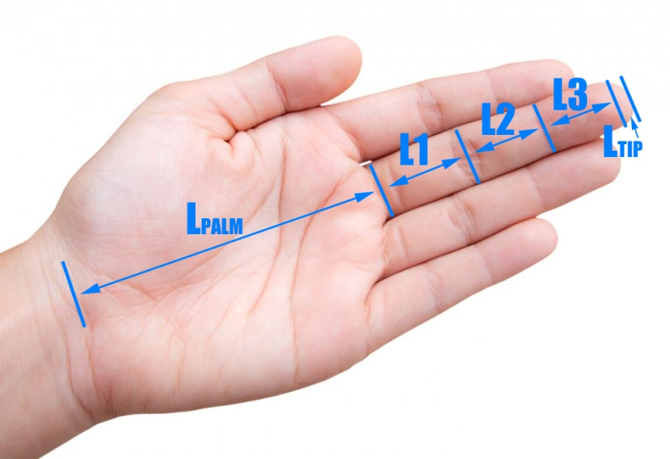
Hand Size
Important to match size of an average hand
Hand segment lengths (middle finger):
L1 = 44.6 mm
L2 = 26.3 mm
L3 = 17.4 mm
Ltip = 3.95 mm
Lpalm = 88.2 mm
Palm Width = 79 mm
Finger Width= 19.75 mm

Slide 12
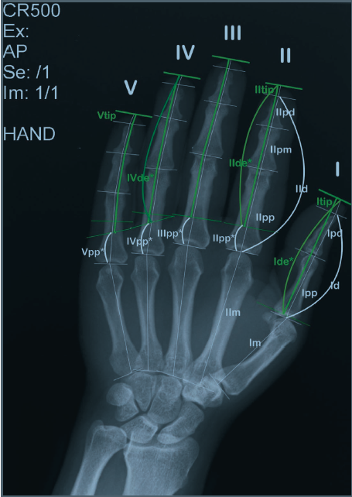
Hand size (continued)
Weight of the hand = 425.7 g
Weight of hand & forearm = 1,699.1 g
Finger length ratios:
Index = 0.8*(Middle Length)
Ring Length = 0.93*(Middle Length)
Pinky Length = 0.74*(Middle Length)

Slide 13
Conceptual Design
Primary hand design:
Run by 5 cables attached to motors in the forearm
Hand will be kept straight via dental rubber bands or flat springs
(If there is time, both will be tested)
Grip will be sensed via encoders tracking each motor
Emulate the size and weight of an average human hand
Secondary goals:
Wrist motion
Locking joints
Use with touchscreens
Accurate finger length ratios
Nails

